Slide 1
Ea system view
George Mason University
INFS 774: Enterprise Architecture
Nicholas Vilailack
Professor Barry Barlow

Slide 2
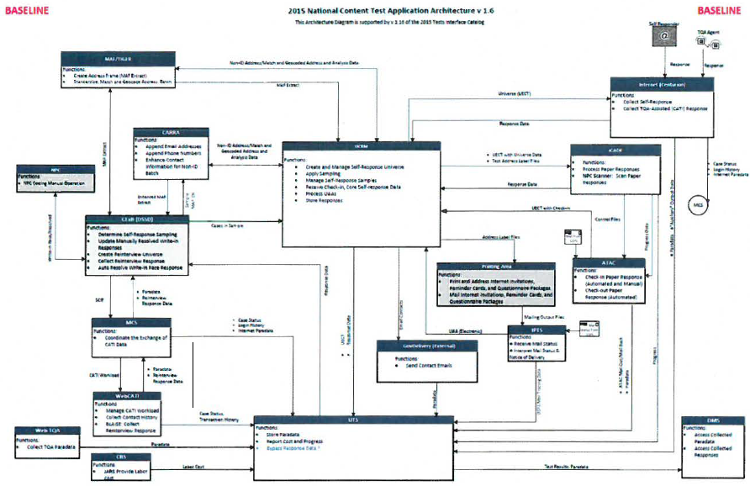

Slide 3

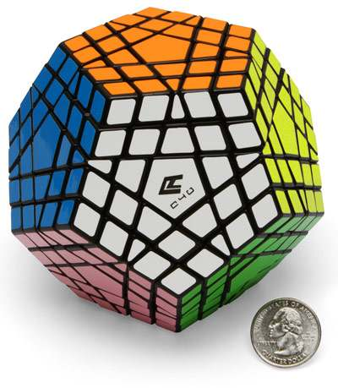
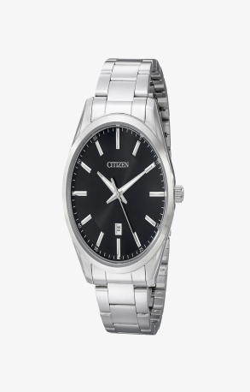


AS-IS (BASELINE)-2015
Notes:
Manual Process (Using Pallet Jack) Not much automation, much of the data transfers were manual.
Highly complex (Advanced cube) Very complex and not in a good way. Having different systems and applications not working in harmony.
Wrist watch, house phone, camera all of these things doing a separate function which eats up time, money, and resources.

Slide 4
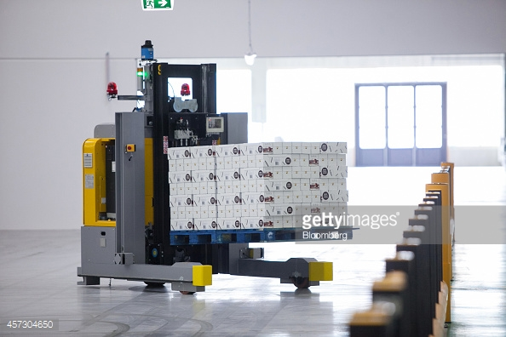
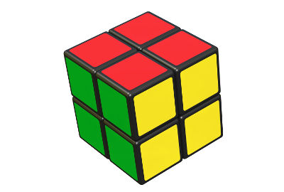

TO-BE (FUTURE)-2020
Notes:
Automatic forklift which is programmed via logic to get boxes from one point to another. Still programmed by humans (manual) but more automatic.
Simpler Rubix Cube-Still the same concepts as before but much more simplified and easier to understand/take apart/implement when needed.
Galaxy S8=Takes all of the functions of the previous and puts it into the one integrated system/solution.

Slide 5
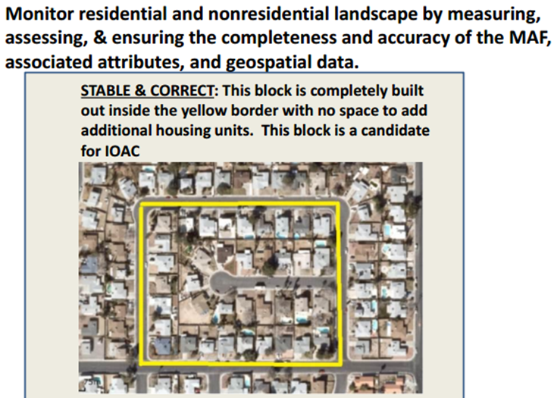
In-Office Address Canvasing (IOAC)
A continuous monitoring to ensure the completeness and accuracy of Master Address File
Leverage existing applications and systems to update the Master Address File
Use of IOAC will reduce costs by not having to do In-Field Address Canvassing
IOAC production started in 2015

Slide 6
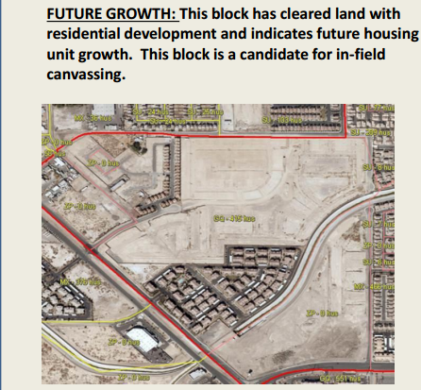
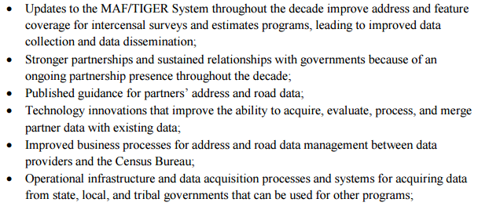

In-Field Address Canvasing

Slide 7
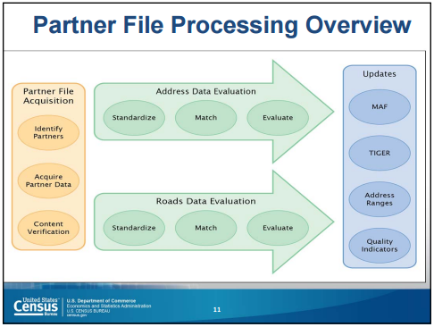

Slide 8
Transition
AS-IS (BASELINE) | TO-BE (TARGET STATE)
Highly complex | Simplified but efficient
Integration of existing + new solutions | Only use what is needed solutions
Crosses several platforms | Only cross needed platforms
Multiple Hardware and Software | Integrate only what is needed
Multiple data sources | Have all data sources aggregated
Little automation, mostly manual process | More automation, less manual
Database links | Enterprise wide methods
Less sharing from lack of ability | More sharing of data
Notes:
Easy to read table that shows the as is differences from the to be targets.
These things are easy to understand and most people can see why they want the target state to be like that.

Slide 9
My thoughts
The Census Bureau is trying to make the best use of tax payer money to accomplish its goal
It’s wants to get the most value from the data collected so that decisions makers have info
It’s doing multiple tests from 2015-2019
To get ready for the 2020 Census
Bold goals every year lead to slim error margins
Staying on schedule will be very difficult
High risk taken to meet goals/stay on schedule
Trying to spend money that isn’t provided yet
Notes:
Having small tests/work load balancing is not the same as having a full scale census.
Going from A to B to C to D to get the final F could be troublesome.
The small tests estimate and don’t take into account some complex factors plus unseen problems may occur (system X will not be able to handle the full data load of a true census)
The bold goals will be supplemented with example Asking for $500 million to get testing done 1 year what happens when you get much less than the amount you want?
Overestimating budget requests and underestimating costs/time usually lead to disaster.

Slide 10


